Slide 1






COMSOL MULTIPHYSICS • CFD MODULE • HEAT TRANSFER MODULE
CFD Simulation and Thermal Design of a
Baffled Shell and Tube Heat Exchanger
Seven Tube, Six Baffle CAD Model • Conjugate CFD Simulation • Independent Manual Verification
Prepared by Frais
September 9, 2026

Slide 2




WHAT WE WILL COVER
Project Roadmap
A complete journey from CAD geometry through CFD simulation to independently verified results.
01
02
03
Objectives
Project Workflow
CAD Geometry
Why this exchanger, and what we set out to prove
CAD to validated results, end to end
Seven tube bundle, six segmental baffles
04
05
06
Physics Setup
CFD Results
Manual Validation
Turbulent flow and conjugate heat transfer
Temperature, velocity and pressure fields
Independent hand calculations, cross checked
BAFFLED SHELL AND TUBE HEAT EXCHANGER
2

Slide 3
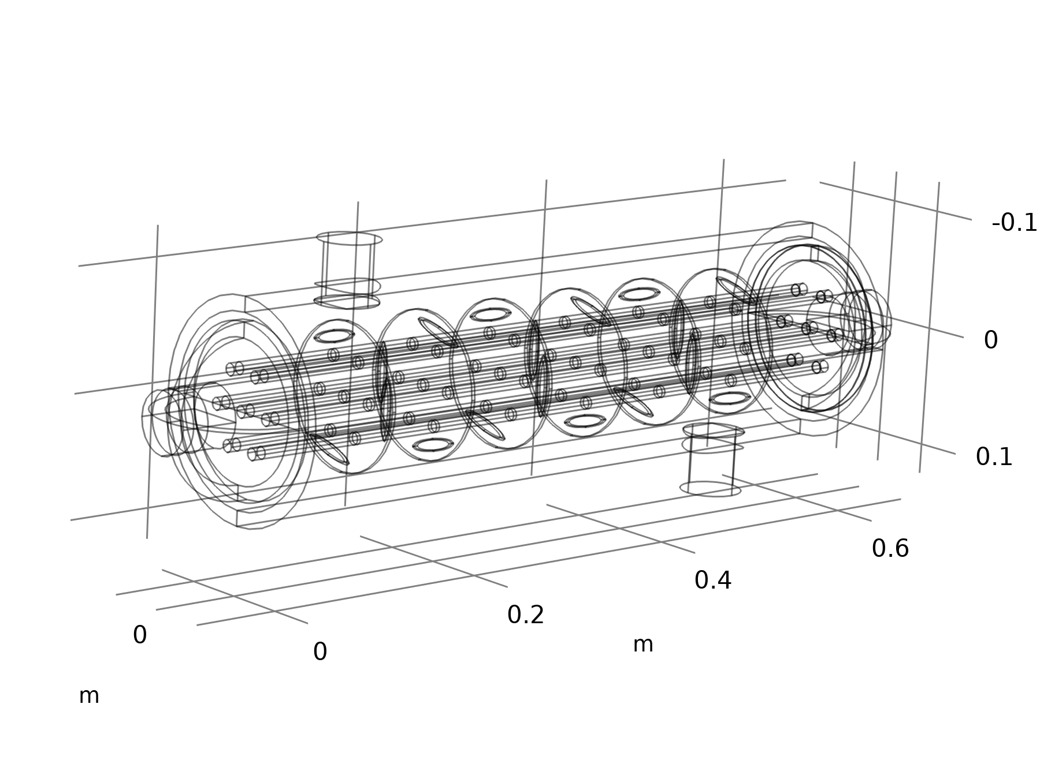


INTRODUCTION
What Is a Baffled Shell and Tube Exchanger?
The workhorse of industrial heat transfer. One fluid flows inside a bundle of parallel tubes; a second fluid flows through the surrounding shell, guided across the tubes by a series of baffle plates.
Baffles support the tubes
Prevent sagging and flow induced vibration along the bundle
Baffles force cross flow
The shell side fluid zig zags across the tube bank instead of flowing straight
Cross flow boosts heat transfer
Substantially higher shell side coefficient than plain axial flow
This project: 7 tubes • 6 segmental baffles • counter current shell and tube design
BAFFLED SHELL AND TUBE HEAT EXCHANGER
3

Slide 4
GOALS OF THIS STUDY
Project Objectives
01
02
03
04
Model the Geometry
Simulate the Physics
Extract Field Results
Verify Independently
Build an accurate parametric CAD model of the seven tube, six baffle exchanger
Couple turbulent flow with conjugate heat transfer across the tube walls
Capture temperature, velocity and pressure fields, and port averaged values
Hand calculate energy balance, LMTD, U and effectiveness NTU from first principles
BAFFLED SHELL AND TUBE HEAT EXCHANGER
4

Slide 5





FROM CONCEPT TO VERIFIED RESULT
Project Workflow
1
2
3
4
5
6
CAD Modelling
Meshing
Physics Setup
CFD Solve
Post Processing
Manual Validation
Parametric geometry: shell, tubes, baffles, nozzles
Free tetrahedral mesh with wall boundary layers
k epsilon turbulence and conjugate heat transfer
Coupled nonisothermal flow, stationary solver
Field plots and port averaged derived values
Independent hand calculation cross check
Every simulated result in this project is cross checked against a hand calculation performed from first principles, not simply restated from COMSOL.
BAFFLED SHELL AND TUBE HEAT EXCHANGER
5

Slide 6

CAD MODEL
Geometry at a Glance
70 mm
Shell outer radius
608.5 mm
Overall shell length
7
Parallel tubes, 10 mm OD, triangular 30 mm pitch
6
Segmental baffles, 80 mm pitch, alternating cut
BAFFLED SHELL AND TUBE HEAT EXCHANGER
6

Slide 7

COMPONENT BREAKDOWN
Anatomy of the Exchanger
Shell
Tube Bundle
70 mm outer radius cylindrical shell with 9 mm thick end caps, 608.5 mm overall length
7 tubes of 10 mm outer diameter on a 30 mm triangular pitch, running the full shell length
Baffle Plates
Nozzles
6 segmental baffles, 60 mm radius by 3 mm thick, spaced 80 mm apart with alternating cut orientation
Two radial inlet and outlet stubs mounted on the shell wall at diagonally opposite ends
BAFFLED SHELL AND TUBE HEAT EXCHANGER
7

Slide 8

MODEL SETUP
Materials
Aluminium
Water (Liquid)
Solid: tube walls, baffles, shell
Fluid: hot shell side and cold tube side
Temperature dependent properties (density, viscosity, heat capacity, conductivity) evaluated locally, not held constant
Density
2700 kg/m³
Thermal conductivity
238 W/(m·K)
Property | Cold, ~36°C | Hot, ~59°C
Density | 994 kg/m³ | 984 kg/m³
Viscosity | 6.9×10⁻⁴ Pa·s | 4.7×10⁻⁴ Pa·s
Specific heat | 4178 J/(kg·K) | 4185 J/(kg·K)
Conductivity | 0.62 W/(m·K) | 0.65 W/(m·K)
Specific heat
900 J/(kg·K)
Thermal expansion
2.3 × 10⁻⁵ /K
BAFFLED SHELL AND TUBE HEAT EXCHANGER
8

Slide 9



SIMULATION SETUP
Physics and Boundary Conditions
Hot Inlet (Shell)
0.5 kg/s @ 70.0°C
Hot Outlet (Shell)
48.1°C, gauge P ≈ 0 Pa
Baffled Exchanger
Cold Outlet (Tube)
47.5°C, gauge P ≈ 0 Pa
Cold Inlet (Tube)
0.5 kg/s @ 25.0°C
k epsilon Turbulence
Conjugate Heat Transfer
Adiabatic Shell
RANS model with wall functions at all fluid solid boundaries
Nonisothermal Flow multiphysics coupling
Thermal insulation applied to all outer boundaries
BAFFLED SHELL AND TUBE HEAT EXCHANGER
9

Slide 10
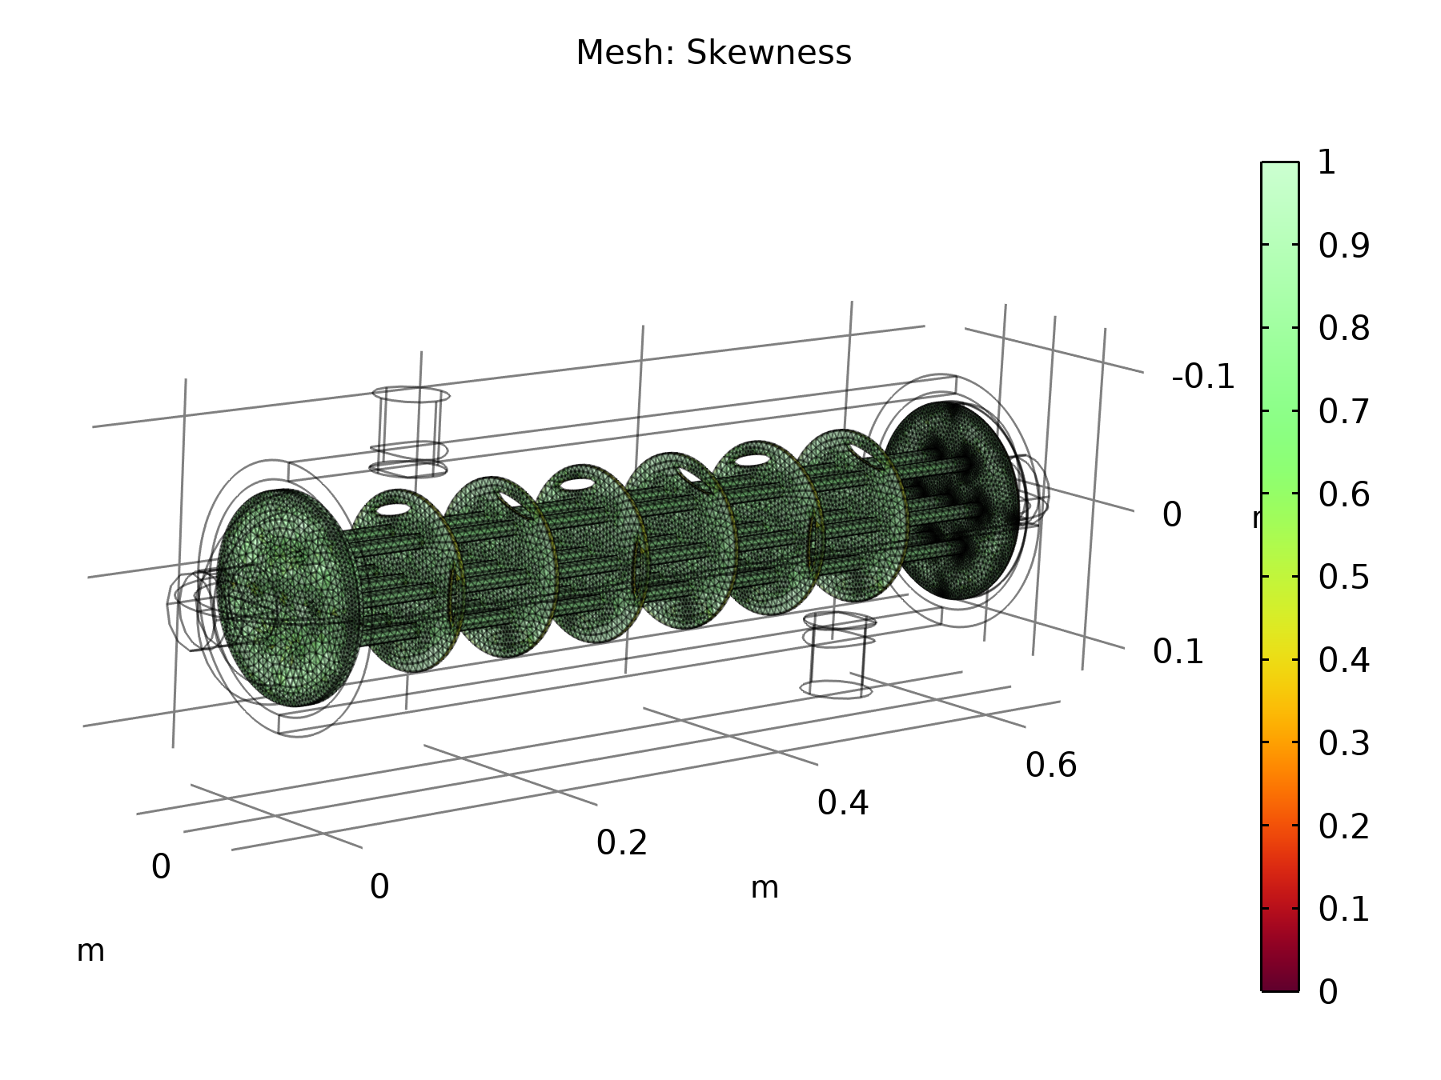
DISCRETISATION
Computational Mesh
Free Tetrahedral
Unstructured mesh with local refinement near tubes and baffle edges
5 Layers
Boundary layer inflation at all walls, 2.5x stretching factor
2.12 to 11.2 mm
Fine local element size around 5 mm tube walls and nozzles
High Quality
Skewness metric close to 1 throughout the fluid domain
BAFFLED SHELL AND TUBE HEAT EXCHANGER
10

Slide 11
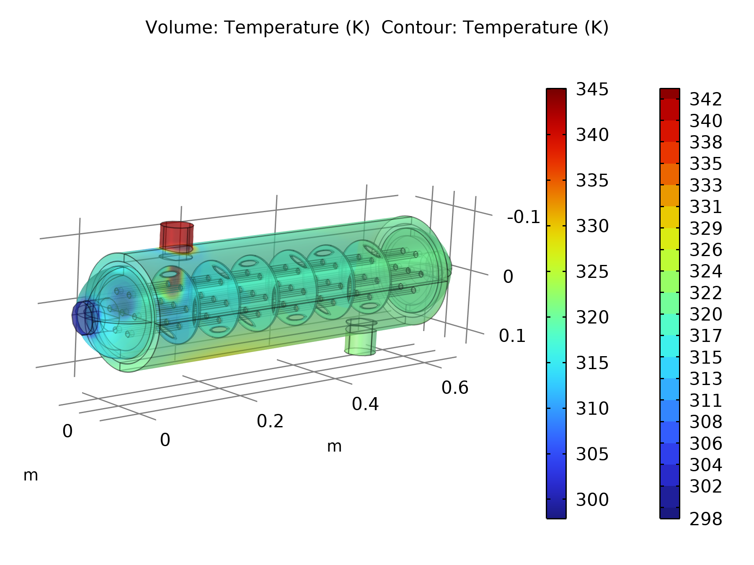
CFD RESULTS
Temperature Field
HOT STREAM (SHELL)
70.0°C → 48.1°C
0.5 kg/s water, cooled by 21.9°C across the shell
COLD STREAM (TUBES)
25.0°C → 47.5°C
0.5 kg/s water, heated by 22.5°C through the tube bundle
Hot and cold ports sit at opposite ends of the shell, confirming true counter current operation.
BAFFLED SHELL AND TUBE HEAT EXCHANGER
11

Slide 12
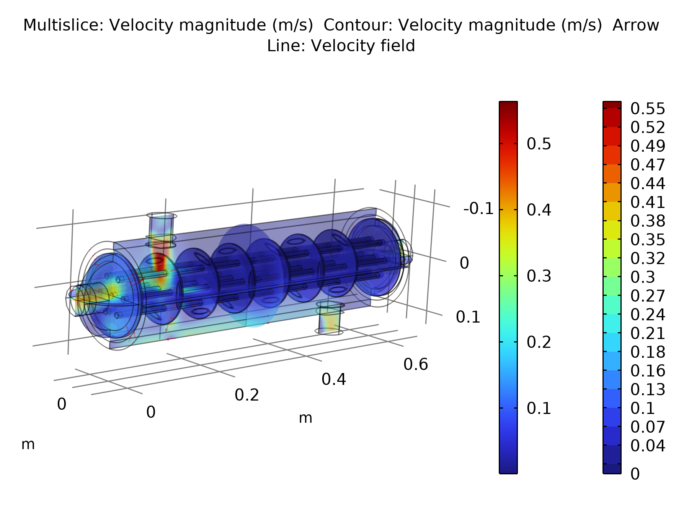
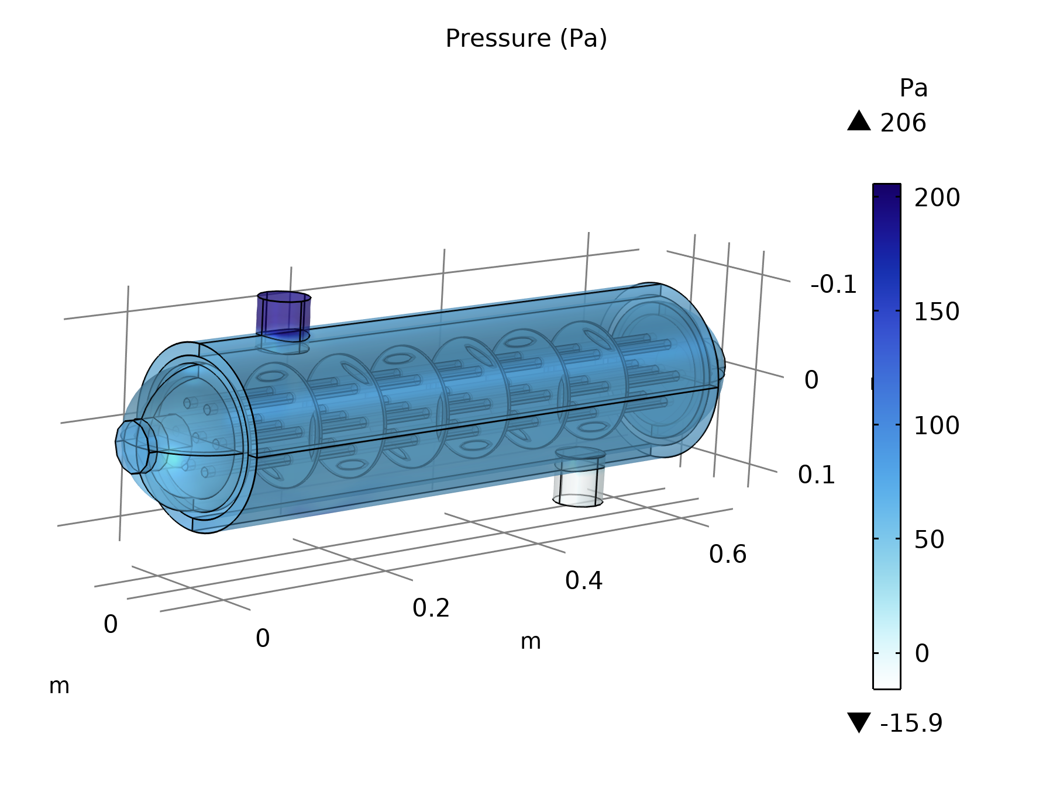
CFD RESULTS
Velocity and Pressure Fields
Peak local velocity ≈ 0.55 m/s
Peak inlet pressure ≈ 206 Pa
Velocity Magnitude
Static Pressure
Flow accelerates through the nozzle and baffle windows, sweeping in a zig zag cross flow over the tube bank.
Pressure falls smoothly from the hot inlet nozzle toward the outlets, held at 0 Pa gauge.
BAFFLED SHELL AND TUBE HEAT EXCHANGER
12

Slide 13

INDEPENDENT FIRST PRINCIPLES CHECK
Manual Validation Roadmap
Every quantity below is computed by hand from the port averaged CFD temperatures and pressures only, not restated from COMSOL.
1
2
3
4
5
6
Energy Balance
LMTD
Area and U
Effectiveness NTU
Reynolds Check
Pressure Drop
Q hot vs Q cold, closes to 0.68%
Counter current log mean dT is about 22.7 K
Tube surface area, U about 15 180 W/m2K
Cross check, U about 15 190 W/m2K
Confirms turbulent flow, both streams
198 Pa shell side, 81 Pa tube side
The two independent routes to the overall heat transfer coefficient U agree to within 0.1%, confirming a thermally consistent solution.
BAFFLED SHELL AND TUBE HEAT EXCHANGER
13

Slide 14
BY THE NUMBERS
Key Results Dashboard
46.2 kW
22.7 K
15 180
49.3%
Heat Duty, Q
Log Mean dT (LMTD)
Overall U, W/(m2K)
Exchanger Effectiveness
0.97
0.68%
198 Pa
81 Pa
NTU
Energy Balance Closure
Shell Side Pressure Drop
Tube Side Pressure Drop
BAFFLED SHELL AND TUBE HEAT EXCHANGER
14

Slide 15
TWO INDEPENDENT ROUTES, ONE ANSWER
Validation Cross Check
LMTD Method
Effectiveness NTU Method
Q = U × A × F × LMTD
NTU = ε / (1 − ε)
U ≈ 15 180
U ≈ 15 190
W / (m²·K)
W / (m²·K)
Agreement within 0.1%, providing strong internal cross validation of the manual calculation
BAFFLED SHELL AND TUBE HEAT EXCHANGER
15

Slide 16
WHAT THE NUMBERS TELL US
Discussion and Insights
Thermally converged solution
Turbulence model justified
The energy balance closes to within 0.68%, confirming the adiabatic shell CFD solution is physically consistent.
Reynolds numbers of about 13 000 (tube side) and 11 500 (shell side, local) confirm the k epsilon RANS choice.
Baffles are doing their job
Room to improve effectiveness
Bulk shell velocity is only about 0.03 m/s, but local acceleration through baffle windows reaches 0.55 m/s, driving turbulent cross flow heat transfer.
At NTU about 0.97 and effectiveness about 49%, more tubes, baffles, or shell length would meaningfully raise effectiveness without a large pressure drop penalty.
BAFFLED SHELL AND TUBE HEAT EXCHANGER
16

Slide 17
SUMMARY
Conclusion
A CAD model and conjugate CFD simulation of a seven tube, six baffle shell and tube heat exchanger were built and solved in COMSOL Multiphysics, coupling k epsilon turbulence with conjugate heat transfer through the tube walls.
Independent hand calculations, energy balance, LMTD, effectiveness NTU, Reynolds number, and pressure drop, were carried out from first principles using only the geometry and the port averaged CFD outputs.
46.2 kW
0.68%
0.1%
49.3%
Heat Duty
Balance Closure
U Cross Check Agreement
Effectiveness
Together, these results demonstrate that the CFD solution is thermally consistent, and that it can be used with confidence for further design iteration of this baffled shell and tube heat exchanger.
BAFFLED SHELL AND TUBE HEAT EXCHANGER
17

Slide 18
Thank You
Questions and Discussion Welcome
Frais
CFD Simulation and Thermal Design of a Baffled Shell and Tube Heat Exchanger • COMSOL Multiphysics

